Slide 1

Diabetes Prediction
12/7/2023

Slide 2
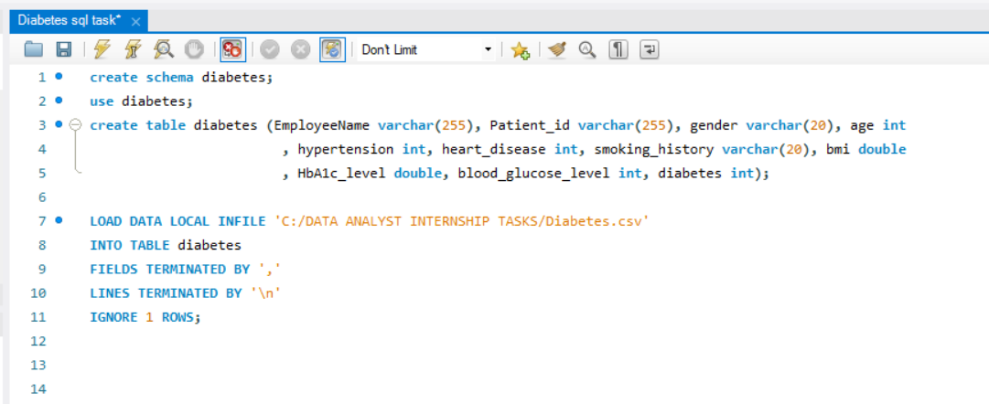
Schema Creation and Data Import for Diabetes Dataset.

Slide 3
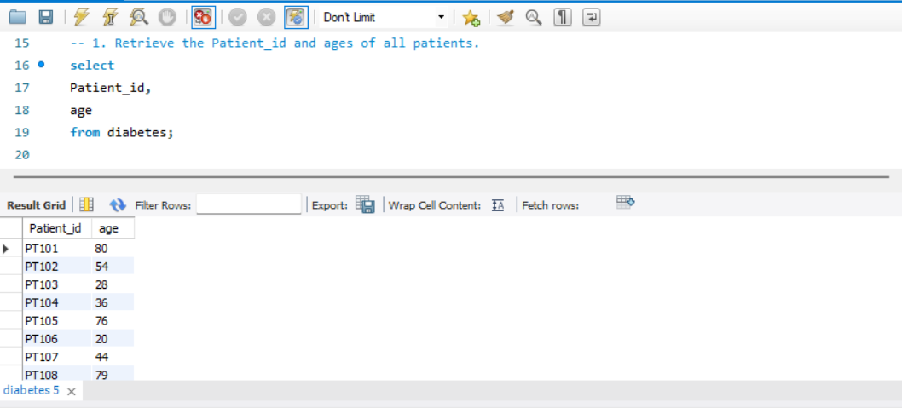
Question 1: Retrieve the Patient_id and ages of all patients.

Slide 4
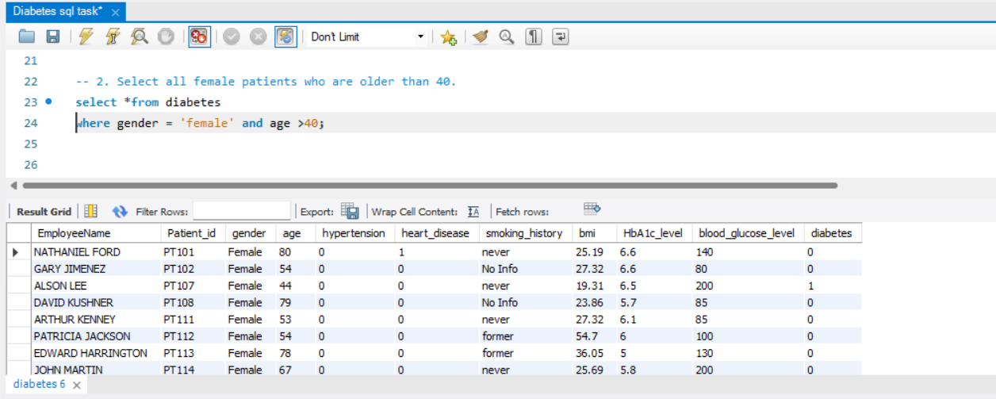
Question 2: Select all female patients who are older than 40.

Slide 5
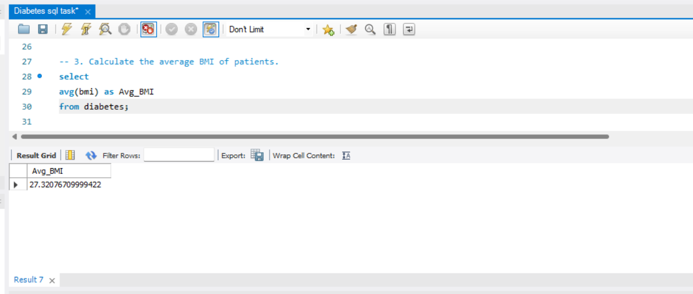
Question 3: Calculate the average BMI of patients.

Slide 6
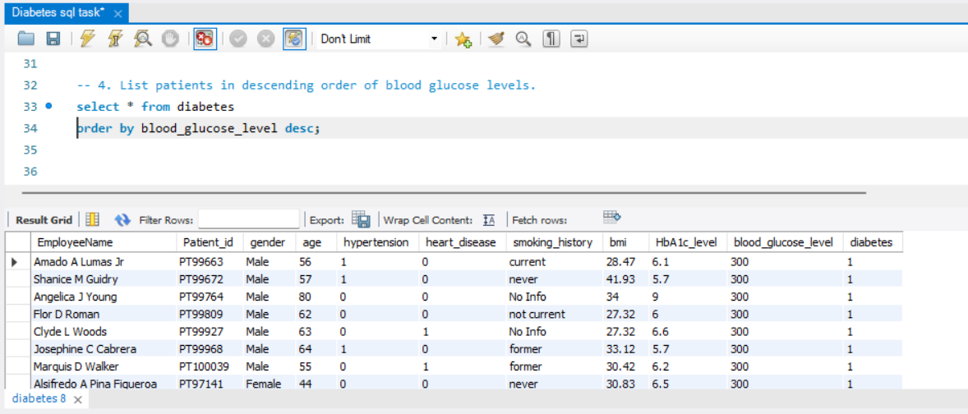
Question 4: List patients in descending order of blood glucose levels.

Slide 7
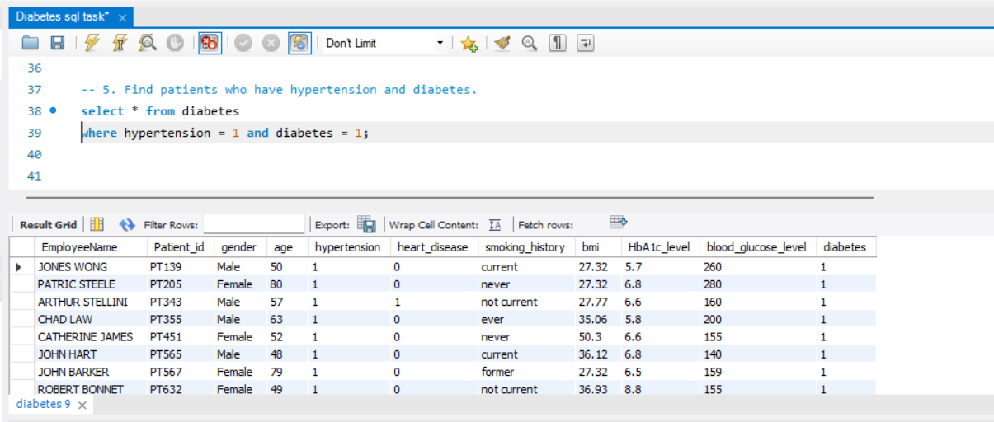
Question 5: Find patients who have hypertension and diabetes.

Slide 8
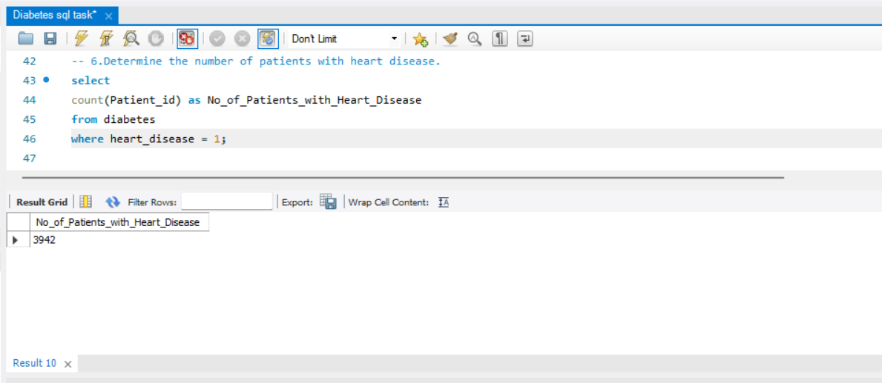
Question 6: Determine the number of patients with heart disease.

Slide 9
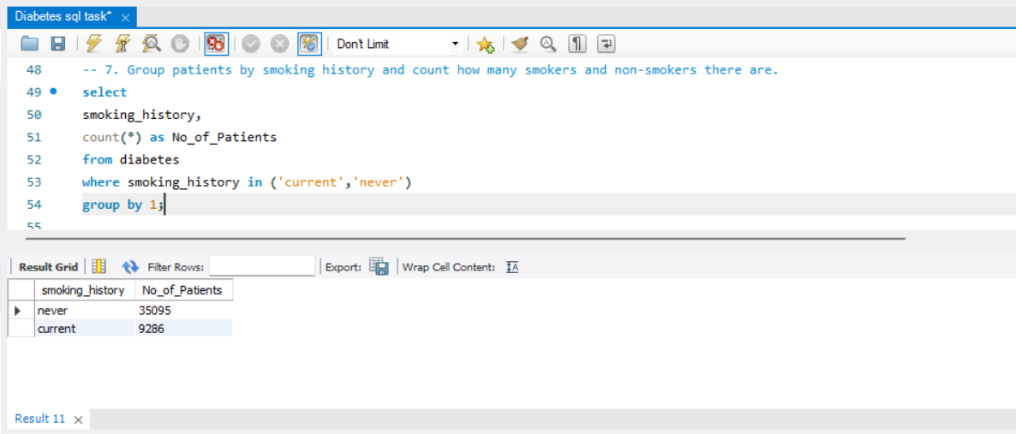
Question 7: Group patients by smoking history and count how many smokers and non-smokers there are.

Slide 10
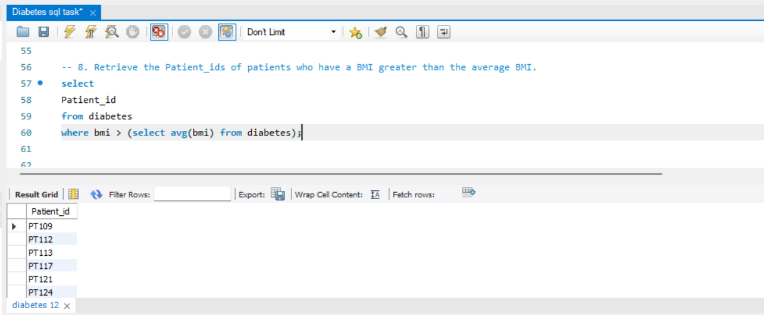
Question 8: Retrieve the Patient_ids of patients who have a BMI greater than the average BMI.

Slide 11
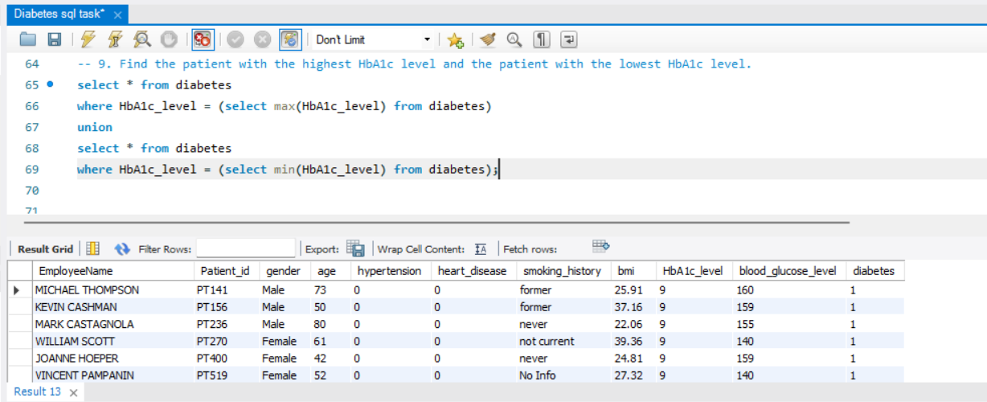
Question 9: Find the patient with the highest HbA1c level and the patient with the lowest HbA1c level.

Slide 12
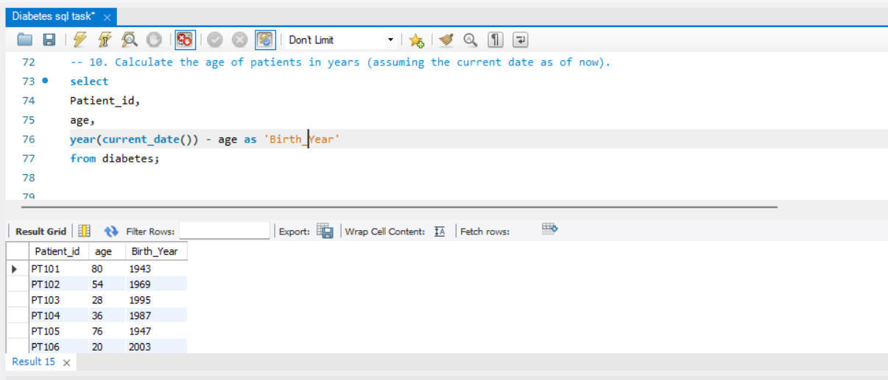
Question 10: Calculate the age of patients in years (assuming the current date as of now).

Slide 13
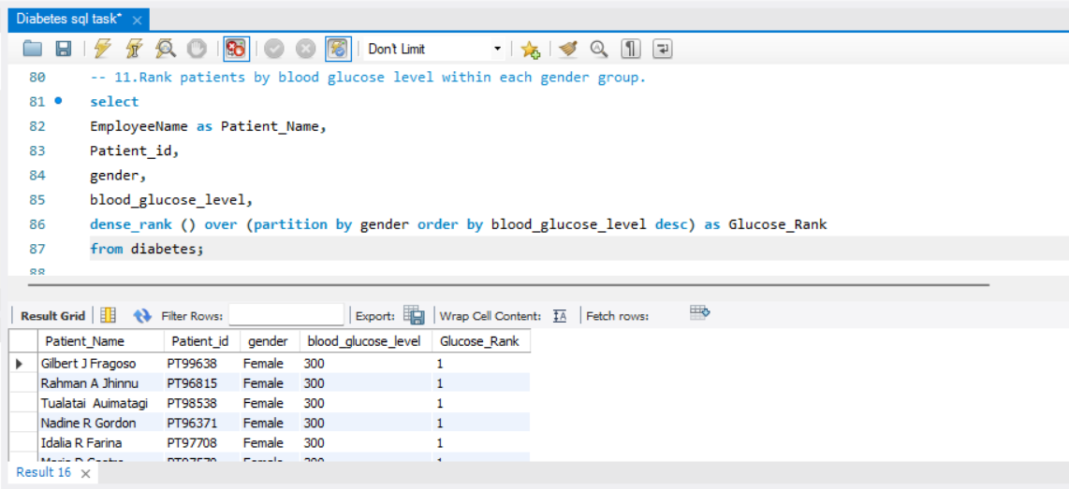
Question 11: Rank patients by blood glucose level within each gender group.

Slide 14
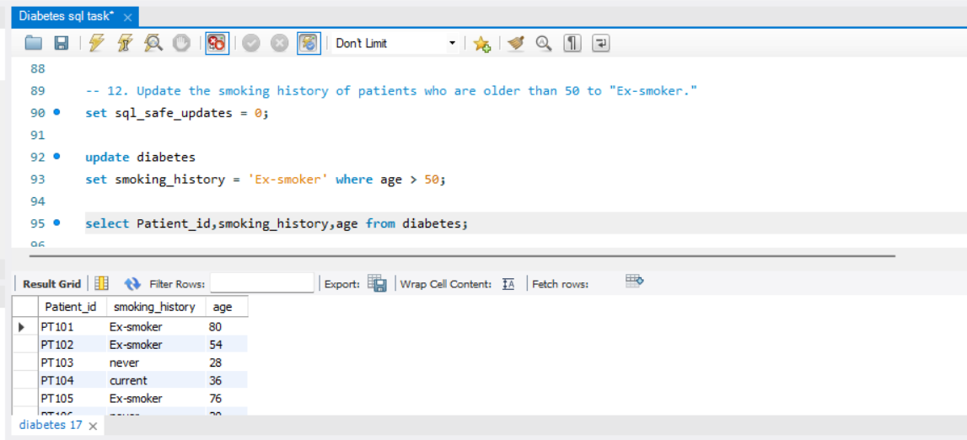
Question 12: Update the smoking history of patients who are older than 50 to 'Ex-smoker.'

Slide 15
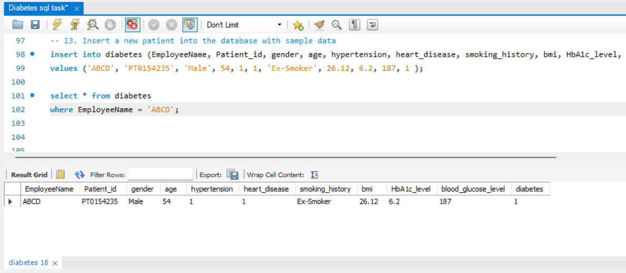
Question 13: Insert a new patient into the database with sample data

Slide 16
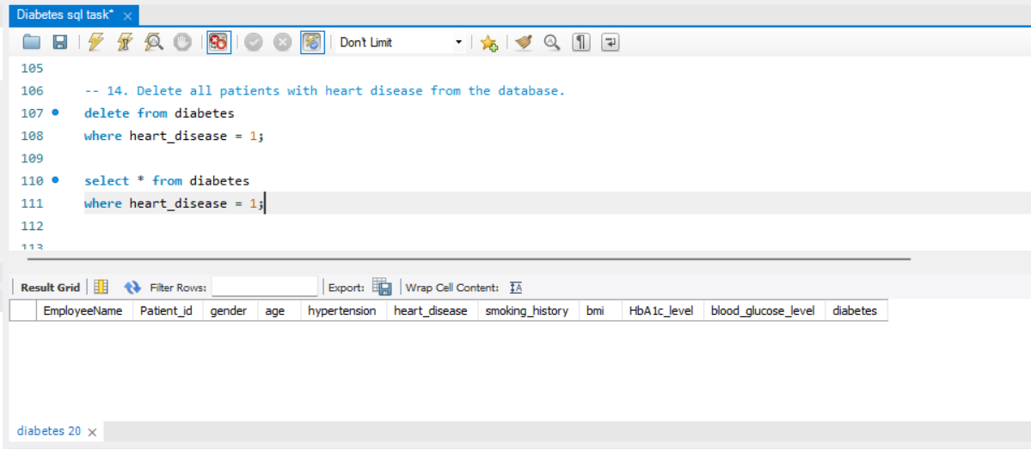
Question 14: Delete all patients with heart disease from the database.

Slide 17
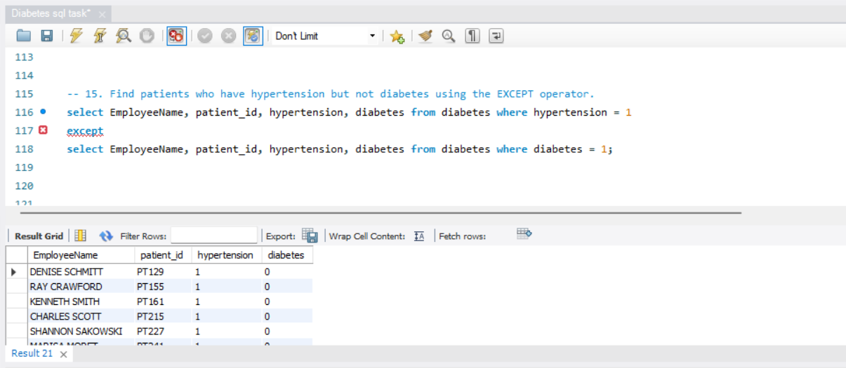
Question 15: Find patients who have hypertension but not diabetes using the EXCEPT operator.

Slide 18
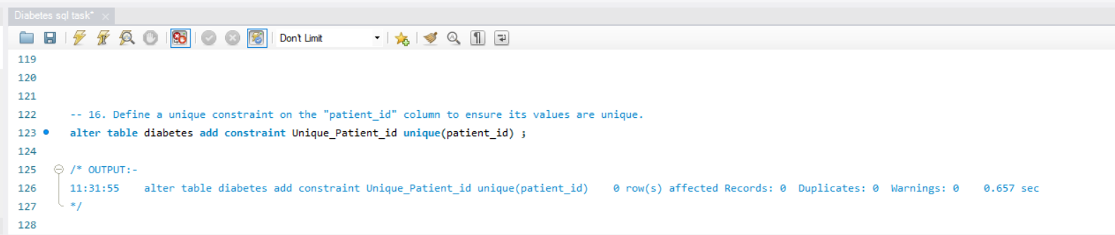
Question 16: Define a unique constraint on the 'patient_id' column to ensure its values are unique.

Slide 19
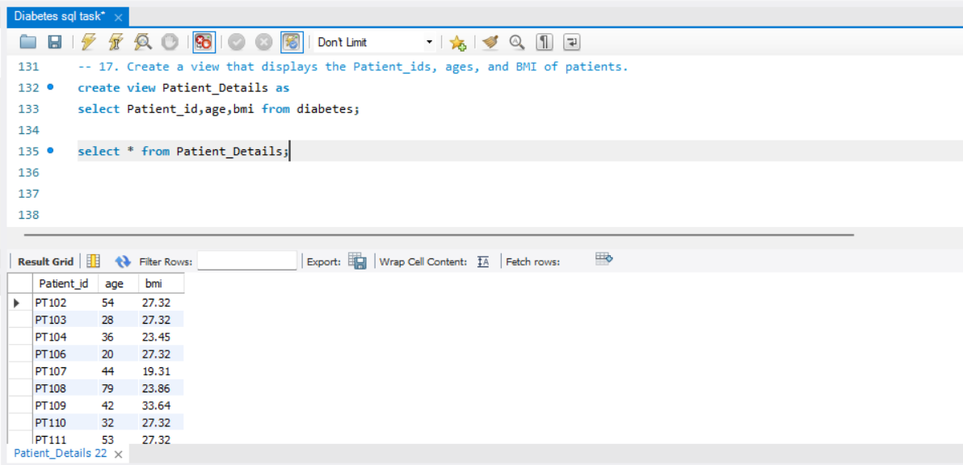
Question 17: Create a view that displays the Patient_ids, ages, and BMI of patients.

Slide 20
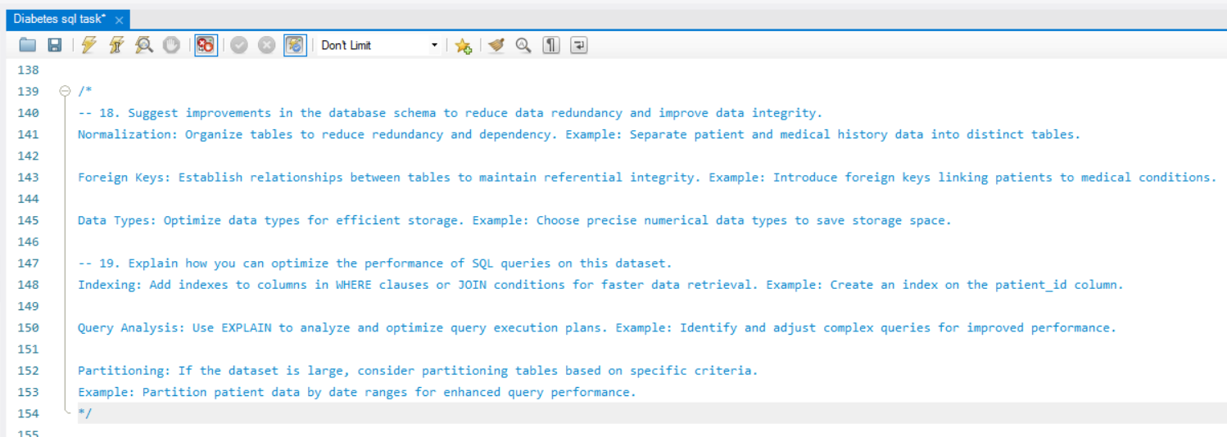
Question 18,19:

